Slide 1
Wisconsin Attorney General Brad D. Schimel’s
Open Government Summit
July 29, 2015
Madison Concourse Hotel

Slide 2
An Overview of Wisconsin’s Public Records Law
Anne m. bensky
Assistant attorney general,
Wisconsin department of justice

Slide 3
The Attorney General's special role in open government
Public Records
  Interpretation by attorney general. Any person may request advice from the attorney general as to the applicability of this subchapter under any circumstances. The attorney general may respond to such a request. Wis. Stat. § 19.39
Open Meetings
  Interpretation by attorney general. Any person may request advice from the attorney general as to the applicability of this subchapter under any circumstances. Wis. Stat. §19.98

Slide 4
The Attorney General's special role in open government
Formal & Informal Opinions, letters and memoranda
Direct public interaction
  PROM handled 281 matters since January 1, 2015 from private citizens, governmental officials, state and local agencies, the press, students, criminal defendants, inmates
    Enforcement actions
    Amicus briefs
    Defending state agencies (including DOJ), the legislature and the Governor's office (15 – 20 cases per year)
    About 10 AAGs with special expertise in open government

Slide 5
History of the PRL and sunshine laws in Wisconsin pre-dating Wis. Stat. s. 19.31 et seq
      County of Jefferson V. Besley, 5 Wis. 134 (1865)
      Wis. Stat. § 19.21
      Wis. Stat. § 19.31 et seq., 1981 Senate Bill 250, Chapter 335, Laws of 1981, published 1982
See 1983 Marquette Law Review article: The Wisconsin Public Records Law, by Linda de la Mora, Volume 67, Issue I, Fall 1983, Article 4, page 65.

Slide 6
The Public Records Law
What it is: Provides access to records that exist at the time the request is made
What it is not: The public records law is not a general records retention statute: See Wis. Stat. § 16.61
See Public Records Board Reference Materials

Slide 7

The Public Records Board is responsible for the preservation of important State records, the orderly disposition of State Records that have become obsolete and cost-effective management of records by State agencies.
The Public Records Board has oversight and accountability for the State's Records Program. The Board conducts its work through collaboration with Wisconsin governmental entities to assist in their compliance with records retention and preservation requirements. Statutory authority may be found at Wis. Stat. Sec. 16.61.
Website: http://publicrecordsboard.wi.gov/
The Document Library contains several records retention schedules and Record Retention/Disposition Authorization forms, as well as training materials, other reference materials, and a list of state agency records officers.

Slide 8

Policy Declaration
representative government
informed electorate
all persons
entitled
greatest possible information regarding the affairs of government
official acts of those officers and employees
an integral part of the routine duties of officers and employees
presumption of complete public access
only in an exceptional case may access be denied

Slide 9
Cornerstone of Wisconsin's sunshine law
... any requester has a right to inspect any record. Wis. Stat. § 19.35(1)(a)
  Wis. Stat. § 19.32(3) defines requester
  Very broad: anyone, inside or outside of the state, who is not a committed or incarcerated persons asking for records about themselves or their children

Slide 10

Except as otherwise provided by law..."

Slide 11


Slide 13


Slide 14

Except as otherwise provided by law..."
Exceptions within the PRL:
    Wis. Stat. § 19.36
    Wis. Stat. § 19.35(1)(am)1-3
Other State and Federal Statutes
    Some are more straight-forward than others: Compare Wis. Stat. § 146.82 (confidentiality of patient health care records & HIPAA with the Drivers Privacy Protection Act (DPPA))
See: Wisconsin Public Records and Open Meetings Handbook, Appendix D for comprehensive list of Wisconsin statutory exceptions.

Slide 15
"Except as otherwise provided by law..."
Request to enjoin release by Records Subject
  Wis. Stat. § 19.356 litigation
  Typically, Court conducts de novo balancing test based on in camera review of records

Slide 16
Public policy balancing test
What it is: What is best for the public
It does not balance purely private interests against the public interest – but, sometimes private interests align with the public interest
  Employee disciplinary records
  Agreements/ MOUs to receive confidential information for public purposes
    Federal/state law enforcement sharing
    Trade secrets/proprietary business information

Slide 17
Public policy balancing test
What facts should Authorities and Courts consider? (Ardell v. Milwaukee Bd. of Sch. Dirs., 2014 WI App 66)
  Who the requester is
  What will the records be used for
  Where the records will end up
  Why is the requester asking for the records
  How the requester will use the records
  Personal safety concerns of the records subject(s)
  Privacy concerns in the digital age

Slide 18
How to provide greater access and who pays for it
    Fees, location, legal review, redaction
    Responding to public records requests should not disrupt other essential governmental functions
    Creation of on-line repositories for public information available worldwide, 24/7
      Who bears the cost of creating and maintaining
    Possible solutions to handle narrow requests that return massive amounts of records: email; data

Slide 19
Public Trust Doctrine for information
We are all stakeholders
Public Interest
Authorities
Requesters

Slide 20
Protecting Public Safety-Policing in the 21st Century
Moderator
Brad D. Schimel-Wisconsin Attorney General
Panelists
James A. Friedman–Attorney, Godfrey & Kahn, S.C.
Samuel C. Hall Jr.–Attorney, Crivello Carlson S.C.
Jill Karofsky–Administrator, Wisconsin DOJ - Office of Crime Victim Services
Jeff Mayers–President, WisPolitics.com

Slide 21
Public Records in the Modern Era
Moderator
Andrew C. Cook-Deputy Attorney General
Panelists
Roger Allen-Assistant City Attorney, City of Madison
Robert J. Dreps–Attorney, Godfrey & Kahn, S.C.
Rick Esenberg–President, Wisconsin Institute for Law and Liberty
Raymond P. Taffora–Vice Chancellor for Legal Affairs, UW-Madison

Slide 22
The Cost of Open Government
Moderator
Delanie Breuer-Assistant Deputy Attorney General
Panelists
Jamie Aulik-County Clerk, Manitowoc County; Legislative Committee Chairman, Wisconsin County Clerks Association
Staci M. Hoffman-Register of Deeds, Jefferson County; President, Wisconsin Register of Deeds Association
Bill Leuders-President, Freedom of Information Council

Slide 23
The Cost of Open Government
Considerations for records custodians in small offices
Jamie J. Aulik
Manitowoc County Clerk

Slide 24

Local units of government take pride in being open
Local government officials work in the community, and directly with local media and the public
Local elected officials (a.k.a. records custodians) understand who pays salaries and bills, and are directly accountable to constituents
We want people to be involved in their local government

Slide 25
Public records requests are a balancing act for local offices
Balancing Act #1: Public's right to know vs. protecting the integrity of the record
Balancing Act #2: Public's right to know vs. confidentiality
Balancing Act #3: Public's (at large) right to know vs. customer
Service responsibility to the residents the office serves

Slide 26
Case Study – Ballot Audits
Request was to audit electronically tabulated ballots, and involved a group traveling to a number of county clerk offices around the state in mid to late 2012
Public records law, of course, provides access to inspect records
Government Accountability Board provided guidance that no one other than election officials were authorized to touch ballots
Election officials and staff spent days flipping over ballots

Slide 27
Racine County experience with ballot audits
Staff spent 57.25 labor hours in room while the audit took place. Figure does not include time spent assembling, organizing, moving materials, scheduling, and other preparations required to fulfill the request
The audit was stretched over a 10 week period, because they had to arrange times when the group had enough counters, and when the county had enough coverage to take care of the workload in the office
At an average cost of $31.25/hour, the county spent $1,789.06 on staff time alone. Again, that figure does not include preparation time and other supplies related to the audit

Slide 28

Other areas requiring clarification
Does an electronic version of a record necessarily follow the same disclosure laws as the record itself?
Is the copy fee of a scanned and emailed document the same as a hardcopy version of the document?
What is the responsibility of an authority when the requestor requires uploading documents?

Slide 29
The Cost of Open Government
Staci M. hoffman
President, Wisconsin register of deeds association

Slide 30
Contrary to Popular Belief, our goals include:
Transparent government
Assistance to our constituents
Fulfilling requests in a timely manner
Helpful and not a hindrance to open government
Fiscally responsible to the taxpayers

Slide 31
Tightened Budgets and Limited Resources
During these economic times, we have been asked to reduce staff either through layoffs or attrition
Limited staff to do daily department functions and statutory obligations
Open records requests have created new positions, overtime and comp time
What should come first open records requests or daily duties?

Slide 32

Costs
There is a real cost to providing open records
  Staff time
  Additional IT Fees
  Added Hardware and Software requirements
  Additional allocated costs – overhead costs
  Additional storage requirements
  Risk Management costs
  Increased records retention policy fees
    Documents, emails, Facebook, Twitter, social media, dash cams, body cams
    Additional server needed for email storage $15,000 plus $2,500 annual maintenance

Slide 33
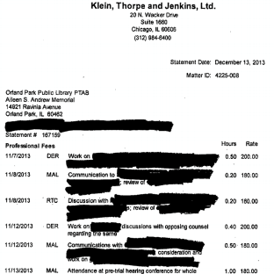
Redaction
We have federal and state laws that require redaction from public record
HIPAA – health issues, medicines
Juvenile Information
Social Security Numbers
Financial Account Information
Informant Identification
  Names, addresses, telephone numbers, email address, voice recordings, hand writing samples

Slide 34
Example – Sheriff’s Department
Records Request 20 Year Old Death
One Court Report consists of 778 pages
38 juveniles were involved – redaction required
Medical conditions and medications – redacted
63 video and audio to be redacted
Dispatch records to be reviewed
Software available for part of the request
Mostly manual
A month has been spent on this case so far, there are many months to go
There are hundreds of other cases in the mean time

Slide 35
Average Monthly Work Load
Standard Accident Reports 77
Contact History Reports 80
Family Court 2
Co. District Attorney Reports 15
Avg. Request (non-accident) 20
Complex Reports 55
Medical Records 4
Challenging Request 1
Total monthly requests 254

Slide 36
Actual Costs
Full time Open Records Clerk-$63,800/yr.
Part time Open Records Clerk-$31,900/yr.
Temporary Open Records Clerk-$5,000/yr.
That’s $100,700 in staff time alone!
    PLUS
IT Allocation-$1,100/unit
Indirect Costs-share of $922,000
Hardware
  CD DVD Burners - $250
  Computers/monitor $950/ea
  Office Equipment - $1,000
Redaction Software - $3,100
  Annual Maint. Fee $620

Slide 37

Register of Deeds Concerns
Data Harvesting
Redaction of Personal Information
Statutory Fees
Uniform Fees
Property Fraud
Keeping up with Technology
  Software $160,000
  Annual Maintenance $19,000/yr

Slide 38
Reimbursement?
Should the taxpayer pay for requests through an increased tax levy?
Should the requester pay the actual costs?
How do you calculate the actual costs?
Should payment be made up front?
  How can we determine the amount of time
Should there be standardized fees?
Should there be standardized formats?
Should the statutory fees be updated?
Do reports have the same .25/page fee?

Slide 39
The Cost of Open Government
Moderator
Delanie Breuer-Assistant Deputy Attorney General
Panelists
Jamie Aulik-County Clerk, Manitowoc County; Legislative Committee Chairman, Wisconsin County Clerks Association
Staci M. Hoffman-Register of Deeds, Jefferson County; President, Wisconsin Register of Deeds Association
Bill Leuders-President, Freedom of Information Council

Slide 40
Wisconsin Department of Justice
Office of the Attorney General
Open Government Summit
July 29, 2015
Wisconsin’s Open Meeting Law—Overview and Discussion
Technological Advances and the Law – Some Examples from the PSC

Slide 41
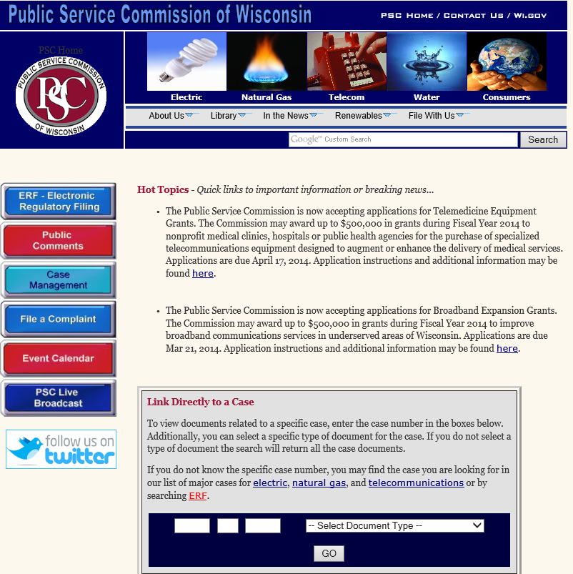
Notice Requirements, Wis. Stat. § 19.84

Slide 42
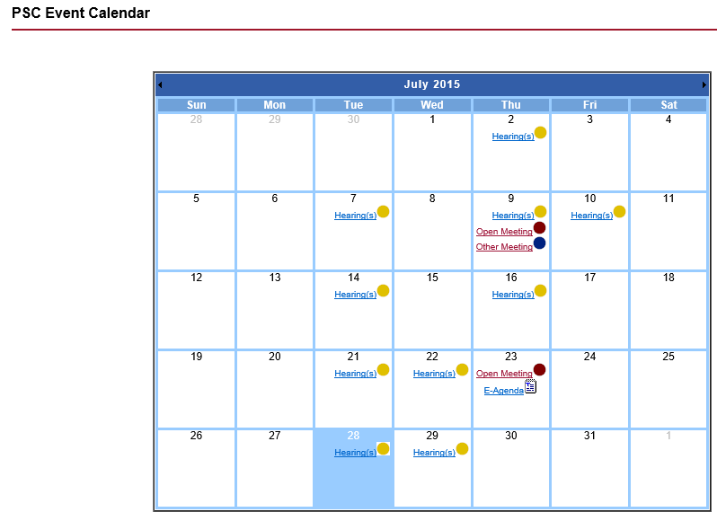
Notice Requirements, Wis. Stat. § 19.84

Slide 43
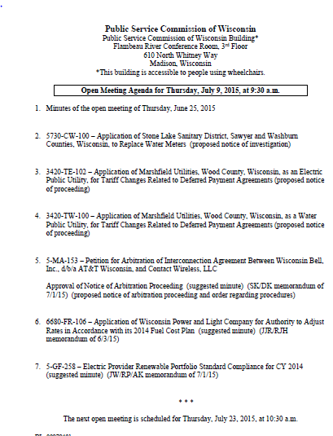
Notice Requirements, Wis. Stat. § 19.84

Slide 44
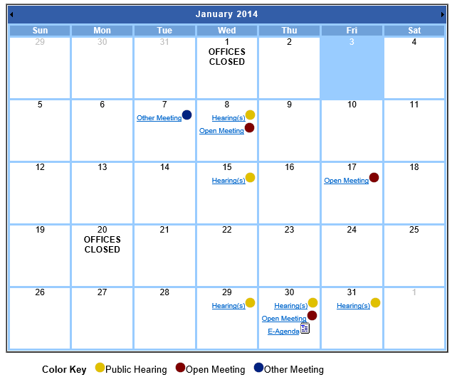
Public E-Agenda

Slide 45
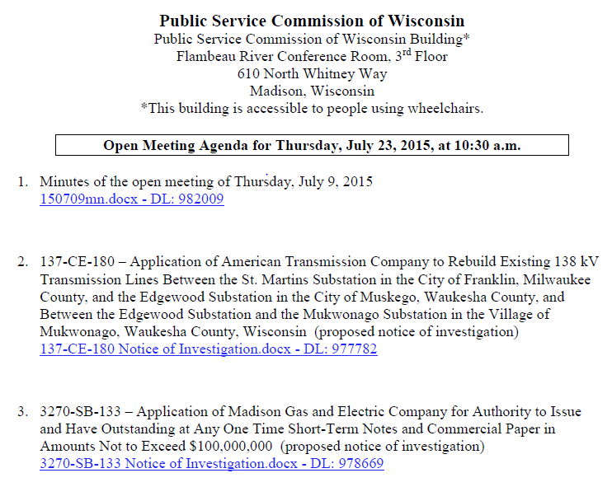
Public E-Agenda

Slide 46
Accessibility and Public Participation

Slide 47
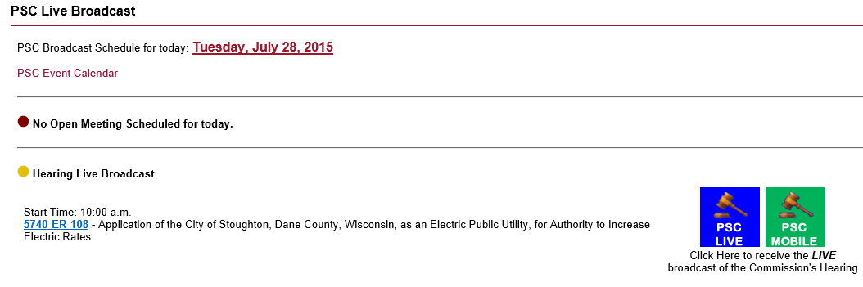
Accessibility and Public Participation

Slide 48
Wisconsin’s Open Meetings Law-Overview and Discussion
Moderator
David V. Meany-Administrator, Wisconsin DOJ-Division of Legal Services
Panelists
Chris Hardie–Former Executive Editor, La Crosse Tribune; President, Wisconsin Newspaper Association
Andrew T. Phillips–Attorney, von Briesen & Roper, S.C.
Cynthia Smith–General Counsel, Wisconsin Public Service Commission

