Slide 1
Firearm Safety Course
Anytown Police Department, Sheriff’s Office, Tech College,
or Instructional Organization
Leave firearms in their cases. Do not handle any firearms unless directed by the instructor.
Notes:
Welcome slide displayed during student entry to training location.
This presentation was updated January 27, 2017.

Slide 2
Course Introduction
Instructor introduction
Student introductions
Facilities
Restrooms
Breaks
Cell phones
Course Materials

Slide 3
Course Overview
Firearm Safety
Safe Carry Considerations
Legal Implications of CCW
Concealed Carry of Weapon (CCW) Licensing

Slide 4
Course Safety Rules
ONLY HANDLE WEAPONS WHEN DIRECTED BY THE INSTRUCTOR
You are responsible for safety
If you see an unsafe act, immediately notify the instructor
If anyone handles a weapon when not directed by the instructor, immediately notify the instructor
No ammunition should be present
If you have ammunition here, tell your instructor and follow the instructor’s directions
If you have questions, or if the instructor’s directions are not perfectly clear, ask for clarification!
Notes:
Everyone is a safety officer.
You must have a safety plan for the course. See the Instructor Guide for more information.

Slide 5
What We’ll Discuss Next: Firearm Safety
The Four Fundamental Firearm Safety Rules
Additional Safety Considerations
Handgun Parts Identification
How to Determine if a Handgun is Loaded
How to Safely Unload a Handgun
Weapons in Your Home
Safe Storage
Children and Weapons

Slide 6
Fundamental Firearm Safety Rules
Nearly all accidental firearm injuries and deaths result from failure to follow these rules
These rules must be followed whenever you handle a firearm
New users: Practice the rules so they are second nature.
Experienced users: Have you become complacent? Do not allow your experience to turn into complacency.

Slide 7
Fundamental Firearm Safety Rules
Treat every gun as if it is loaded
Even if you are certain the weapon is empty, always treat it as a loaded gun.
Don’t do anything with an unloaded gun that wouldn’t be safe with a loaded gun. Many people have been accidentally killed by “unloaded” guns.
Never accept another person’s word that a gun is unloaded—verify this for yourself.

Slide 8
Fundamental Firearm Safety Rules
2. Never let the muzzle cross anything you are not willing to destroy
Imagine a laser beam coming out of the barrel of your weapon. Never let that laser touch anything—even for a moment—that you aren’t willing to shoot.
Keep the weapon pointed in a direction that will safely stop any bullet fired.

Slide 9
Fundamental Firearm Safety Rules
Keep your finger off the trigger and outside the trigger guard until you want the gun to fire
Keep your index finger extended along the frame of the weapon until your sights are on your target and you want to fire.
This prevents you from unintentionally firing because you were startled or clutched something with your other hand.

Slide 10
Fundamental Firearm Safety Rules
4. Know your target and what’s beyond it
Always positively identify your target as what you intend to shoot.
Be absolutely certain of what or who you are shooting.
Bullets may travel through a target and strike something behind it.
You may miss, especially under stress.

Slide 11
Additional Safety Considerations
Do not allow children or unauthorized users access
Obtain firearm training
Handle weapons only while sober
No alcohol or illegal drugs
No over-the-counter drugs, narcotics, or prescription drugs that could impair judgment or physical abilities
Inspect and maintain your weapon and CCW equipment
Use the correct ammunition
Follow manufacturer recommendations
Notes:
Instructor Resources contain multiple illustrations of lots of safety violations.
Charges filed in River Falls shooting death, Eau Claire Leader Telegram, June 29, 2011.
Jordan Walker press release and criminal complaint.
Madison Police Department press release.
Possession of a weapon while intoxicated is a criminal offense.

Slide 12
Handgun Parts Identification
“Handgun” is a general term. Includes different types:
Revolver
Single action
Double action
Pistol
Semi-automatic
Derringer
Single-shot
Most common: double action revolvers and semi-automatic pistols
Notes:
This is not a firearms training course. Discussion of the difference between action types, and especially the advantages and disadvantages of each type, is time-consuming and beyond the scope of this course.

Slide 13
Revolvers
Revolving cylinder contains cartridges
Double-action
Trigger cocks then releases hammer
Swing-out cylinder allows rapid reloading
Single-action
Requires manually cocking hammer before pulling trigger
Reload requires pushing out fired cases one at a time
Notes:
This should be a very brief summary. This is not a firearm training course…this is a firearm safety course. You may just wish to address double-action revolvers, stating they’re the most common, and merely mention that other kinds exist.

Slide 14
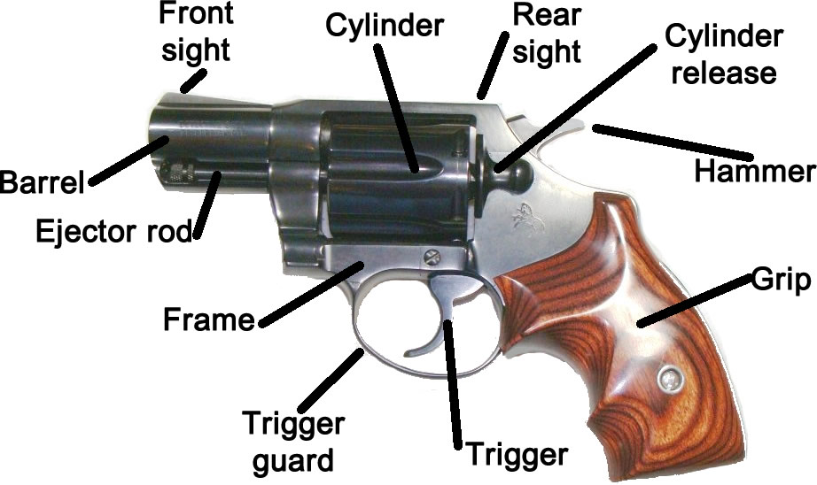

Slide 15
Unload a Revolver
Push the cylinder release
Swing the cylinder out of the revolver
Examine each chamber for ammunition
Look into each chamber
Feel the rear of the cylinder
If cartridges are present, point the revolver up and press down sharply on the ejector rod
Notes:
Different brands of revolvers require the cylinder release to be pushed in different directions.
This method is for double-action revolvers. Single-action revolvers have a different unloading procedure.

Slide 16
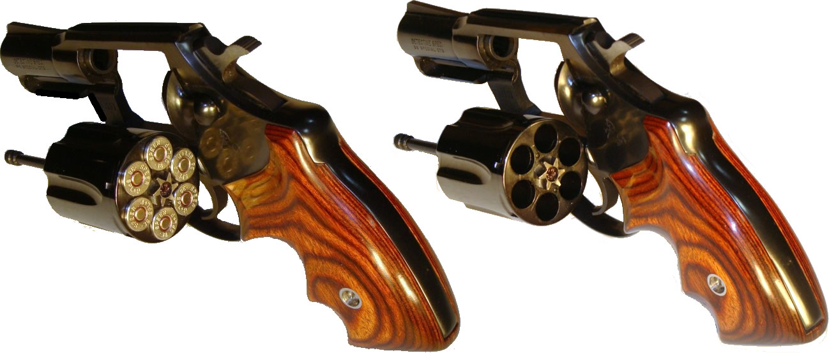
Loaded and Unloaded Revolver

Slide 17
Pistols
Fires cartridge in the chamber of the barrel
Semi-automatic
Ammunition in removable magazine
Energy of fired cartridge causes gun to load new cartridge
Just pulling trigger fires gun until it is out of ammunition
Single-shot
Fires single round in chamber, then requires reloading
Usually used for hunting
Derringer
A double-barreled single shot

Slide 18
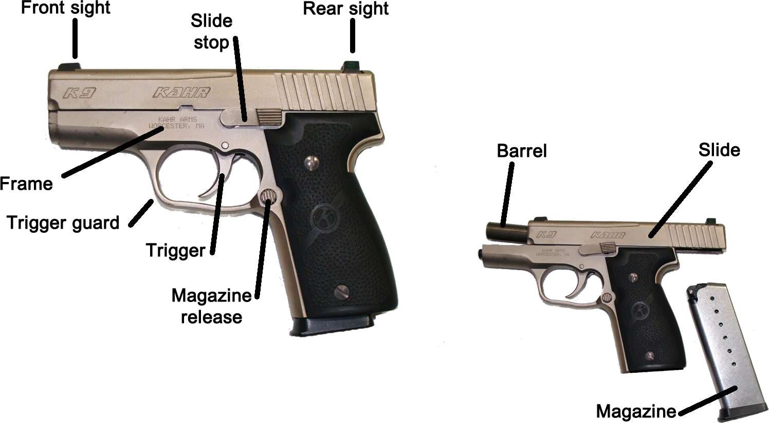

Slide 19
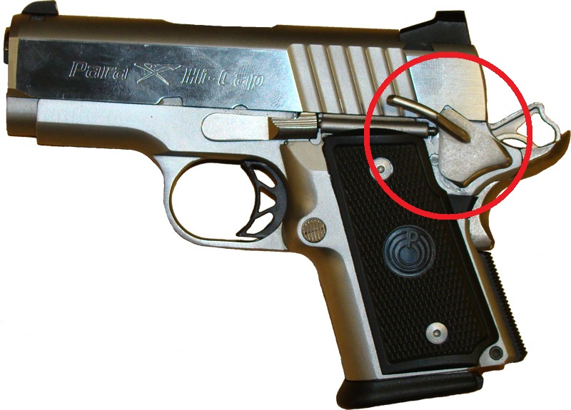
Manual Safety
A lever or button that, when activated, blocks the firing mechanism.
Some pistols have these, some do not.
Always follow the 4 fundamental rules of firearm safety, regardless of whether a safety is activated.
Safeties are mechanical devices that can malfunction, fail, or be accidentally deactivated. Never rely on them.

Slide 20
Unload a Pistol
Caution! If this procedure is performed incompletely or in the wrong order, a cartridge could remain in the chamber and the gun could still be loaded!
First remove the magazine
Lock the slide back using the slide stop
Inspect the chamber for presence of a cartridge
Look into the chamber
Feel that the magazine has been removed and the chamber is empty
Notes:
Emphasize importance of removing magazine first.
Some pistols don’t have extractors (example: Beretta 21A and similar). Some pistols don’t have slide stops (Sig Sauer P232 and others). Alert students that their firearm may require a slightly different method, and that they should follow manufacturer instructions.

Slide 21
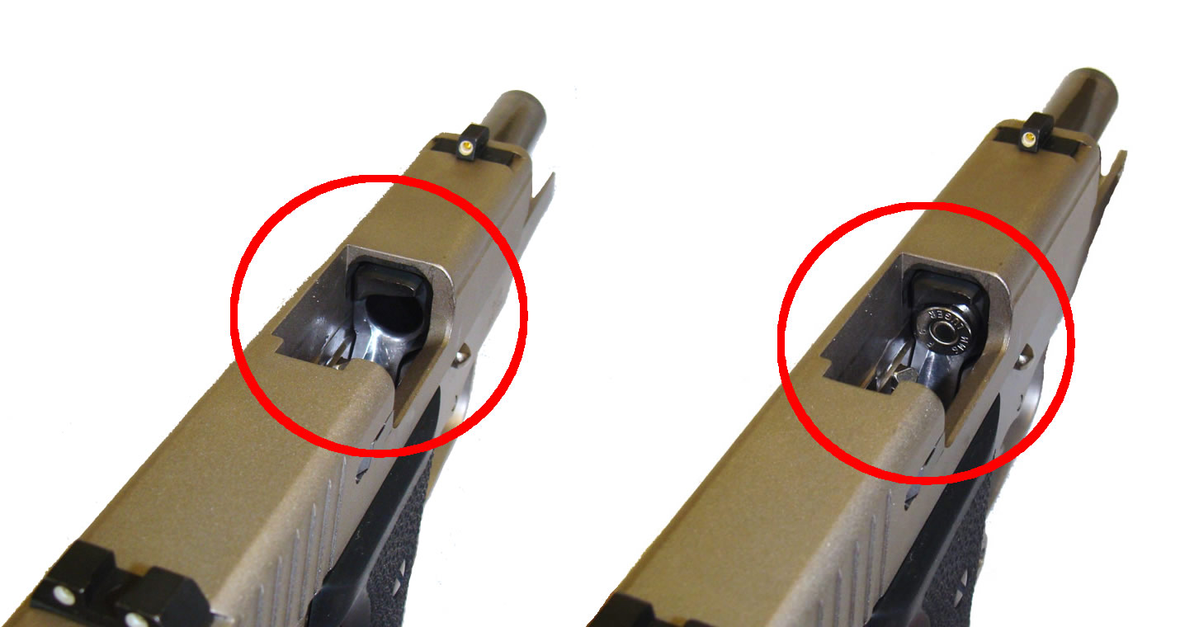
Cartridge Remains in Chamber

Slide 22
Guided Practice: Safely Unload a Handgun
ONLY HANDLE WEAPONS WHEN DIRECTED BY THE INSTRUCTOR.
Obey the Four Fundamental Firearm Safety Rules
Follow all instructor directions
You may already be familiar with these steps
Do not get ahead of the instructor
Assist the instructor by serving as an extra set of eyes

Slide 23
What We’ll Discuss Next: Weapons in Your Home
Safe Storage
Family Safety Plan
Children and Weapons

Slide 24
Safe Firearm Storage
Firearms are safest when least accessible:
Unloaded
Locked up
Ammunition locked in another location
Accessible firearms demand extra precautions

Slide 25
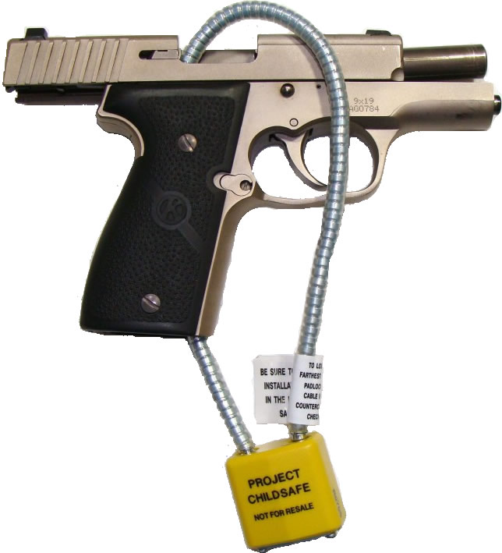
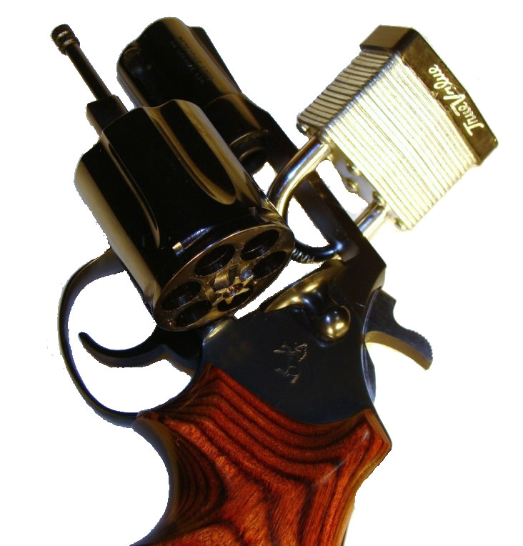
Most Secure: Unloaded with action locked open
Notes:
Other locks are available and other methods could work. For example, commercial trigger locks block trigger access (although, unlike those illustrated, trigger locks don’t require the gun to be unloaded). Follow the manufacturer’s instructions. An example of another effective alternative is field-stripping a pistol and placing a padlock around the slide through the ejection port.

Slide 26
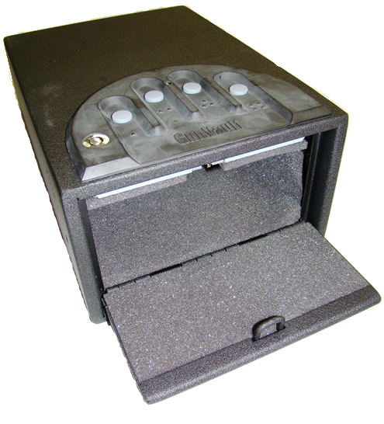
Rapid-access storage box prevents access without knowing the code.
Notes:
Manufacturers offer mechanical locks, electronic locks, and keyed locks.

Slide 27
Children and Weapons
Joshua Lesnick news article
Analyze Wis. Stat. § 948.55
Notes:
See the student manual for Lesnick’s news article.
The Instructor Manual contains an additional link to a March 2012 news article discussing three shootings of children in Washington. In separate incidents, two children were killed and one seriously injured after unsecured guns were retrieved by children—two of them from vehicles. This is a relevant consideration if you are going to a location that prohibits carry—how will you properly secure your gun?

Slide 28
Children – Eddie Eagle
Even when you store safely—do your neighbors?
Teach your children what to do
If you find a gun, STOP!
Don’t Touch.
Run Away.
Tell a Grown-up.
Notes:
Used with the permission of the National Rifle Association.

Slide 29
In-Class Exercise: Develop Your Family Safety Plan
Who will have access?
Who will be taught fundamental rules of gun safety?
Do family members know the hazards weapons pose?
How and where will the weapon and ammo be stored?
Where will the keys or combinations be stored?
Will the plan be updated as children age or family circumstances change?
Will all family members discuss and agree to the plan?

Slide 30
Review: Firearm Safety
The Four Fundamental Rules of Firearm Safety:
Treat…
Never…
Keep…
Know…
Alcohol, illegal drugs, and prescription narcotics—which are ok?
Why is a Family Safety Plan important?
What are some different ways you can lock up your gun?
Questions?

Slide 31
During the Break
DO NOT HANDLE ANY WEAPONS
After the break, we’ll discuss Safe Carry Considerations.

Slide 32
What We’ll Discuss Next: Safe Carry Considerations
Weapon Concealment Methods
Maintaining Control of Your Weapon
Avoid the Need to Use Your Weapon
What to Do When You Encounter Law Enforcement

Slide 33
Weapon Concealment
Many possible methods. Not all of them are safe!
Carry in a consistent manner
If you carry five different ways, will you remember which “flavor of the day” you’re using in the heat of the moment?
Use a quality holster
You can’t just tuck a gun in your waistband and expect it to stay there
Good holster + mediocre gun = you can defend yourself
Bad holster + great gun = you’re unsafe or defenseless
Notes:
Police urge holster use after man shoots his own xxxxx, Arizona Republic, August 7, 2011. http://www.azcentral.com/community/chandler/articles/2011/08/07/20110807cr-penisshot0811.html

Slide 34
Characteristics of a Good Holster
Covers the trigger
Stays in place
Comfortable enough to use for long periods
Retains gun until needed
Releases gun when needed
Gun can be drawn with either hand

Slide 35
Safety Considerations
Different systems have different safety considerations
Mobility
Concealability
Speed of access
Belt Holsters
Ankle Holsters
Holsters in Clothing
Under Arm Holsters
Off-Body Carry

Slide 36
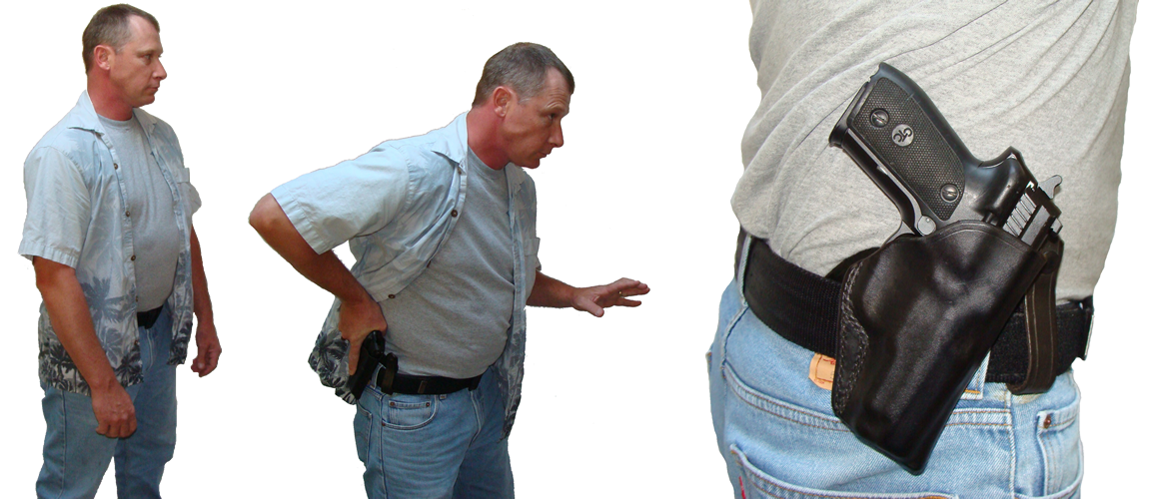
Belt Holsters
Notes:
The “open carry” shown in the right-most picture of each series is for illustration purposes of how the holster rides on the belt. Obviously it is not concealed without a covering garment.

Slide 37
Ankle Holsters
Notes:
Immobilized during draw. Requires two hands.
Easy to reach seated.

Slide 38
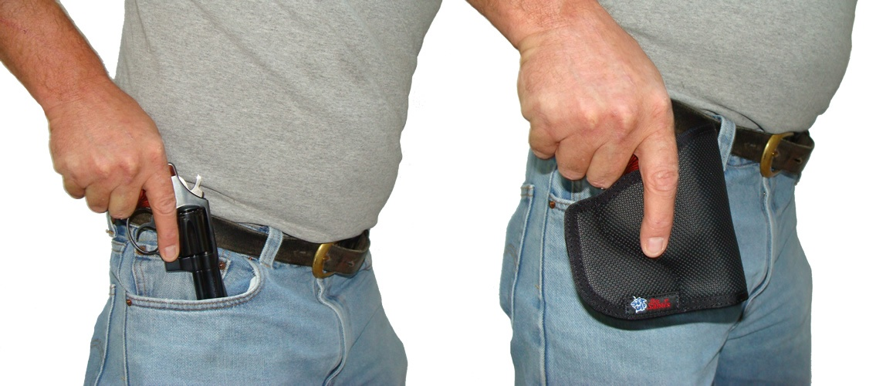
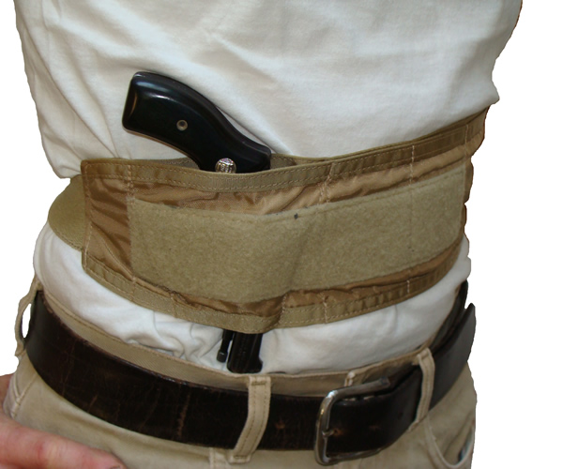
Holsters Worn In Clothing
Notes:
Pocket holsters: can you draw while seated?
Belly bands: “Tuckable.” Two-hands may be needed to draw. (Note: the above belly band is being worn to illustrate what one looks like. More common belly band positions include under the belt in an appendix or cross-draw carry, or at 4-o’clock…all covered by a shirt…but those didn’t photograph well.)

Slide 39
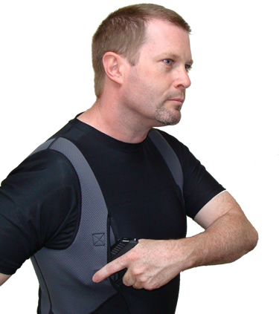
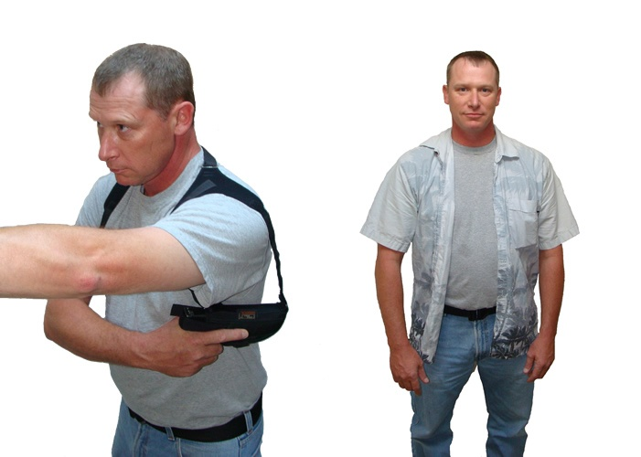
Under Arm Holsters
Notes:
Shoulder holsters might be “under” clothing rather than “in” clothing, but are included here.
Methods have muzzle direction concerns. Drawing incorrectly will point muzzle at self or others. Requires short barrels and concealing garment.

Slide 40
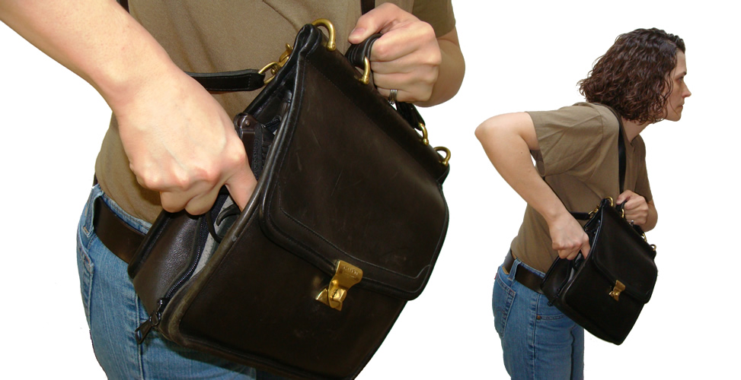
Off-Body Carry
Notes:
Maintaining security. Easy to lose. Purse snatchers. Safety around children.

Slide 41
Maintain Control of Your Weapon
Use a secure carry system. Evaluate your system with an unloaded gun.
Can you do a somersault?
Can you run without holding onto the gun?
Notes:
You must be able to flee from problems—”the Nike™ (as in tennis shoe) defense.” You don’t want your weapon to fall out if you’re pushed or fall down.
When evaluating whether your carry system is secure, USE AN UNLOADED WEAPON. Don’t try to catch a weapon in mid-air, as your grasping hand might activate the trigger.

Slide 42
Maintain Control of Your Weapon
Who sees you carry?
Concealed = not targeted for weapon
Consider personal security information
Who knows you carry? Why should they know?
Notes:
Who needs to know about your precautions? What possible benefit do you receive by broadcasting what steps you are taking—and not taking—to maintain your personal safety?
LE officer homes targeted by burglars seeking weapons.

Slide 43
Avoid Need to Use Your Weapon
Avoid confrontations
Behavior
“Nike™ defense”– run away if reasonable
If it’s so unsafe you don’t want to go without a gun…
why are you going there at all?
Notes:
Be extra polite—don’t act in ways that could escalate a situation. Preventing confrontation is best. Leaving an escalating situation is better than sticking around. Don’t go where people with impaired judgment are hanging out. Little sympathy awaits for a CCW licensee who hangs out with drunk people who like to fight, and then “had no choice” but to shoot. The CCW person might be legal, but that doesn’t mean it was smart.
“Nike™ defense” is the use of your running shoes to escape danger, i.e running away.

Slide 44
Avoid Need to Use Your Weapon
The best way to survive an attack is to avoid it
Be aware of your surroundings
Detect the situation in time to avoid it
Don’t stumble into the middle of an event
Recognize common signs of being evaluated as a victim
Trust your intuition. If you feel uncomfortable in a situation, leave!
De-escalate confrontation
Notes:
Recognize if you are being “sized up.” Instructor may expand upon observation of environment.
Review ee-escalation techniques. See road rage example in the Instructor Manual.

Slide 45
Encounters with Law Enforcement
Tell the officer you have a concealed carry license and are carrying a weapon
Do not reach for the weapon or make any quick movements
Keep your hands visible
Traffic stops
Stay in the vehicle
Roll down your window
Turn on the vehicle’s dome light at night
Place your hands on the steering wheel
Follow the officer’s instructions
Notes:
Although Wisconsin does not have a “duty to inform,” immediately telling the officer is recommended. Mention the CCW license first, and then say where the weapon is located. Try not to blurt out, “I have a gun!” That statement could be misunderstood by the officer.
In certain kinds of non-consensual contacts (Terry stops, etc.), the officer generally has the legal ability to ensure the officer’s safety by disarming others present. In consensual contacts, disarming may be requested but cannot be demanded (or the contact is no longer consensual).
Officer responses could range among any of the following:
1. Little reaction at all.
A smile accompanied by, “You leave your gun in the holster and I’ll leave mine in the holster.”
Directions to leave your hands on the steering wheel for the duration of the stop.
Directions to put your gun in the glove box and then meet the officer at her squad car.
Directions to turn the gun over to the officer for the duration of the contact.
Unless you are arrested, the gun should be returned at the end of the contact.

Slide 46
Officers May Take Different Actions
Policies and procedures may vary around the state
Officers may have information not known to you
Is your car similar to a suspect’s vehicle?
Officers know CCW is legal
Notes:
Understand that you may not have all the information available to the officer regarding why the officer is contacting you. Additionally, officers may have a range of legal options depending on the situation.

Slide 47
Review: Safe Carry Considerations
Why do you want to use a holster?
Name a method of carrying a gun, and identify its relevant safety considerations.
How can you increase your control over your weapon?
What’s the best way to survive a lethal incident?
What should you do if you are stopped for a traffic offense?
Questions?

Slide 48
During the Break
DO NOT HANDLE ANY WEAPONS
After the break, we’ll discuss Legal Implications of CCW.

Slide 49
What We’ll Discuss Next: Legal Implications of CCW
Elements of the Concealed Carry Law
Where You Cannot Carry Your Weapon
Self Defense and the Defense of Others
Defense of Property

Slide 50
Elements of the Concealed Carry Law
Licensees may carry concealed dangerous weapons:
Handgun
Electric weapon
Billy club
A license does not allow carry of a concealed:
Short-barrel rifle
Short-barrel shotgun
Machine gun
Notes:
A license is not required to carry a concealed knife. However, it is illegal to carry a concealed knife if you prohibited from possessing a firearm under Wis. Stat. § 941.29.
“Billy club” is not defined under state statutes.

Slide 51
Elements of the Concealed Carry Law
When carrying a weapon, licensees must also carry:
CCW license and
Current photo driver’s license or identification card
You must show your license upon the request of a law enforcement officer
Notes:
Do not have to carry license or ID when carrying at home, on your land, or in your business.
11/16/15 update: “Military residents” must carry their resident state’s photo DL/ID card, and military identification. 2015 Wisconsin Act 67. Wisconsin residents must carry a WisDOT-issued Driver’s License or ID card.

Slide 52
Elements of the Concealed Carry Law
CCW license is a state license
It does not confer rights on federal property
A CCW license does not change vehicle requirements for rifles or shotguns
Must still be unloaded, and out-of-reach or in plain view
The law does not provide immunity from civil lawsuits
The law does not confer any “extra” self-defense rights
The law does not prevent criminal prosecution for illegal acts of the licensee
Notes:
CCW license is not a “get out of jail free” card.
Long-guns must be unloaded, and out-of-reach or above the windowline (State v Walls).

Slide 53
Where You Cannot Carry A Handgun
Police stations, sheriff’s offices, state patrol stations, or offices of DOJ special agents
Prisons, jails, houses of correction, or secured correctional facilities
The Sand Ridge Secure Treatment Center, the Wisconsin Resource Center, or any secured portion of a mental health institution, including the Maximum Security Facility at the Mendota Mental Health Institute
County, state, or federal courthouses
Municipal courtrooms if court is in session
Beyond airport security checkpoints
Notes:
The above prohibitions do not apply to any of the following:
1. A weapon in a vehicle driven or parked in a parking facility located in a building that is used as, or any portion of which is used as, a location described above.
2. A weapon in a courthouse if a judge who is a licensee is carrying the weapon, or if another licensee whom a judge has permitted in writing to carry a weapon, is carrying the weapon.
3. A weapon in a courthouse or courtroom if a district attorney, or an assistant district attorney, who is a licensee is carrying the weapon.

Slide 54
Where You Cannot Carry A Handgun
Anywhere when under the influence of an intoxicant
On the job, if prohibited by your employer
When “no weapon” signs are posted or you are told weapons are prohibited:
In businesses
On private property or land
In state or local government buildings
At special events
In public or private university or college buildings
See the DOJ “Frequently Asked Questions” document
Notes:
Intoxicant = alcohol, prescription drugs, or any detectable amount of an illegal drug.
Employer cannot prohibit weapon in employee’s vehicle in the employer’s parking lot. Generally the above prohibitions do not include weapons in your own motor vehicle in a designated parking area. See the WisDOJ FAQ document and state statute for more information.
The Instructor Manual contains an additional link to a March 2012 news article discussing three recent shootings of children. In separate incidents, two children were killed and one seriously injured after unsecured guns were retrieved from vehicles. This is a relevant consideration if you are going to a location that prohibits carry—how will you properly secure your gun?

Slide 55
Schools
Felony to carry firearm on school grounds, unless:
School-approved program
Unloaded, encased, and with permission of school to cross grounds to access hunting land
Unloaded, in a case, and out-of-reach in vehicle
Legal hunting in school forest with permission of school
Law enforcement officer or qualified former law enforcement officer
State commission warden acting in official capacity
Misdemeanor to carry within 1,000 feet of school grounds without a CCW license, unless:
One of the above exceptions applies; or
On private property not part of school grounds
Notes:
What about picking up my kids from school? What if I live across the street from a school?
“Schools” refers to K-12 schools, both public and private.

Slide 56
Self Defense & Defense of Others
Gunshots are always deadly force
You cannot use deadly force unless you reasonably believe you are in imminent threat of death or great bodily harm
“Reasonably believe”
Belief must be objective
Belief can be mistaken
Notes:
Reality is not like TV. If you shoot someone in the arm or leg, it is not a “remote-controlled punch” like it might appear in film. Shooting at someone is deadly force.
Reasonable belief = a person of average intelligence in the same situation could be expected to believe the same thing when faced with the same situation. Your belief must be objectively reasonable. For example, a person could have a sincere subjective belief that anyone wearing red pants is a deadly threat, but that belief is not objectively reasonable. Finally, a belief can be reasonable even if it is mistaken. For example, if someone points a gun at you it would be reasonable for you to believe your life was in imminent danger. If the gun was later found to be unloaded, your belief would have been mistaken but still would have been reasonable.

Slide 57
Self Defense & Defense of Others
You cannot use deadly force unless you reasonably believe you are in imminent threat of death or great bodily harm
“Imminent threat”
Intent
Weapon
Delivery system
Preclusion
No other reasonable alternative
Deadly force is a last resort
Notes:
Preclusion example: Attacker is advancing with a 100,000 volt power line, putting the defender under imminent threat of death. The defender has a gun in one hand, and the power switch to turn off the voltage in the other. The defender is fully aware of both options and can consciously choose either action. Preclusion demands that the defender flip the switch instead of shooting. “Is there anything else you could have done besides shoot?” Must be able to answer, “No.”
Wisconsin uses the terms, “Intent, Weapon, and Delivery System.” Many other states use, “Ability, Opportunity, and Jeopardy.” They mean the same thing. Ability = weapon. Opportunity = delivery system. Jeopardy = intent.

Slide 58
Self Defense & Defense of Others
You cannot use deadly force unless you reasonably believe you are in imminent threat of death or great bodily harm
“Death or great bodily harm”
Notes:
"Great bodily harm" means bodily injury which creates a substantial risk of death, or which causes serious permanent disfigurement, or which causes a permanent or protracted loss or impairment of the function of any bodily member or organ or other serious bodily injury. Wis. Stat. § 939.22(14).

Slide 59
Castle Doctrine
In certain circumstances, use of deadly force may be presumed lawful when someone forcibly enters your home, business, or vehicle while you are present
You must still follow all firearm safety rules
Rule four—be certain of your target
Tragic examples of homeowners mistakenly shooting family members believed to be intruders
Regardless of the castle doctrine, you must satisfy the target requirements shown next
Notes:
2011 Wisconsin Act 94 (the castle doctrine bill) is effective as of December 20, 2011. The student text contains the full text of this legislation.
Supplemental hand-out of mistaken-identity shooting in “Instructor Resources.” A similar example is available online, here: http://www.cbsnews.com/stories/2007/05/30/national/main2867791.shtml
Note: the castle doctrine does not justify continued use of deadly force against an intruder when that intruder is no longer in the actor's dwelling. The applicable definition of the actor's dwelling, s. 895.07(1)(h), requires that the part of the lot or site in question be "devoted to residential use." While s. 895.07(1)(h) lists several parts of a residential lot that are part of a "dwelling," it does not include a parking lot. The common denominator of the listed parts of dwellings is that all are property over which the actor has exclusive control. An apartment building parking lot is not exclusive to one tenant or devoted to the residential use of any one tenant. State v. Chew, 2014 WI App 116.

Slide 60
Self Defense & Defense of Others
Target requirements must be met before shooting:
Target acquisition
Target identification
Target isolation
You must stop shooting when the threat has ceased
Chasing your assailant to continue the fight is NOT recommended!
Notes:
Target acquisition. You must have a target. Firing your gun indiscriminately is not acceptable—you must have a specific target.
Target identification. You must identify your intended target as the source of the threat. Just because you have acquired a target doesn’t mean that it is the correct target.
Target isolation. You must be able to shoot without recklessly endangering innocent bystanders.
If you continue the fight, you may be unable to argue self-defense if another lethal encounter ensues. You expose yourself to the possibility of civil or criminal liability.

Slide 61
Self Defense & Defense of Others
If all you have is a hammer, everything looks like a nail
Do you have a plan to defend yourself when you’re not in danger of death or great bodily harm?
Other alternatives are outside the scope of this course
Notes:
Gunfire only authorized if you are in danger of death or great bodily harm. Do you have a plan to defend yourself when you’re not in danger of death or great bodily harm?

Slide 62
Post-Incident Safety
Immediately notify law enforcement
If anyone was wounded, render aid if safe to do so
Secure your weapon when safe to do so
Try to avoid having a weapon in your hand when police arrive
Immediately follow all law enforcement directives Do not turn towards officers with a gun in your hand.
When possible, point out any witnesses and evidence
Notes:
If you drew your gun, even if you didn’t have to fire, you may have been the victim of a crime. Report the crime to authorities so law enforcement can investigate the situation.

Slide 63
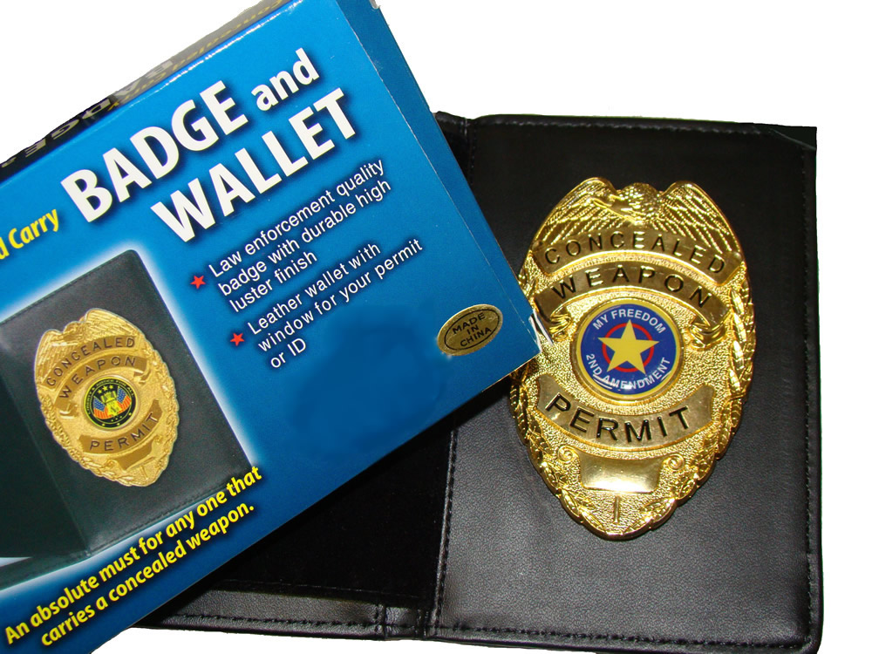
CCW Badges
Do these help police ID you as the “good guy”?
No. Often a tool of police impersonators (illegal)
Doesn’t replace your license
Post-incident actions not helped
Off-duty police taught to follow previous slide’s process
Jeopardize your legal safety
Expose you to accusations of impersonating an officer
Notes:
These badges are not against the law, but they can be used as evidence of an actor’s state of mind and/or their alleged conduct. These “novelty” badges are frequently used by police impersonators. It’s doesn’t matter much that the badge says “Permit Holder” instead of “Police Officer”—bystanders may reasonably believe someone flashing a badge is representing themselves as an officer.
Here’s an example showing how a man was prosecuted for impersonating an officer, using evidence of a badge not even displayed to help gain the conviction: http://findarticles.com/p/news-articles/palm-beach-post/mi_8163/is_20050723/hobe-sound-guilty-impersonating-officer/ai_n51885725/

Slide 64
Defense of Property
Right to use reasonable force in defense of property
Deadly force is not reasonable solely for defense of property
Armed robbery example
Theft example
Potential for situation to escalate. Is it worth the confrontation?
Adams County example
Notes:
First example: A robber points a handgun at you and demands your wallet. Because the robber is imminently threatening you with death, you could shoot to protect your life. You would not be shooting solely to defend your wallet.
Second example: You look outside and see someone trying to steal your car. The suspect starts to get into your car when you order him to stop. You would not be justified in shooting, as you are not in danger and would solely be preventing the theft of property.
Having the right to use reasonable force to defend property doesn’t mean it’s the right choice, or necessarily smart. When would it be appropriate, and when would you be better served to just contact law enforcement? The Instructor Resources section contains a press release from the Adams County Sheriff’s Office illustrating this point.

Slide 65
Review: Legal Implications of CCW
Where are you prohibited from carrying a handgun?
Can businesses post signs that prohibit you from carrying a weapon?
You may only use lethal force when you are in _______ threat of _____ or ______ ______ ______.
What is preclusion?
Can you use deadly force to defend property?
Questions?

Slide 66
What We’ll Discuss Next: CCW Licensing
Overview of License
How to Apply
Suspension and Revocation of Licenses
Changes of Address
Renewing a License

Slide 67
Concealed Carry License Overview
Allows concealed carry of handguns, carry (open or concealed) of electric weapons, and billy clubs
Valid for five years from date of issue
Valid in Wisconsin and states with reciprocity
Does NOT allow you to carry anywhere you want
Notes:
Possession of electric weapons may be illegal in some states with handgun reciprocity—follow the laws of that state.
“Billy club” is not defined in Wisconsin statutes.

Slide 68
Concealed Carry License Overview
Not issued to anyone ineligible to possess a dangerous weapon
Felons
Convicted of misdemeanor domestic violence
Restraining orders, bond, or other court orders
Mental commitments
License does not allow possession of weapons if the licensee becomes prohibited from possessing them
Notes:
Ineligibility discussed at length in student manual and administrative code.
Mere possession of a Wisconsin CCW license card does not make it legal to possess a weapon, if the person is legally prohibited from possessing a weapon. For example, if your driver’s license is suspended or revoked, it is illegal for you to drive even if you still have your driver’s license card in your wallet.

Slide 69
Concealed Carry License
You must carry your CCW license when you carry a concealed weapon
You must carry additional photo ID:
Driver’s License or Identification Card
Military residents must also carry their military identification
Notes:
Driver’s license and identification card must be issued by the licensee’s state of residence. For Wisconsin residents, the DL/ID card must be issued by the Wisconsin Department of Transportation. For military residents, the DL/ID card must be issued by the state of the military resident’s official residency, and the military resident must also carry their military license (identification). Wis. Stat. 175.60(2g)(b)1.

Slide 70
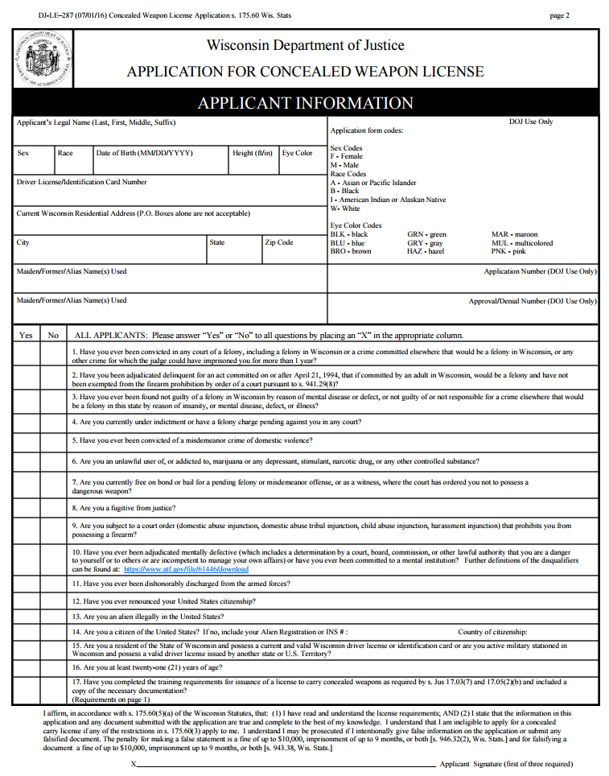
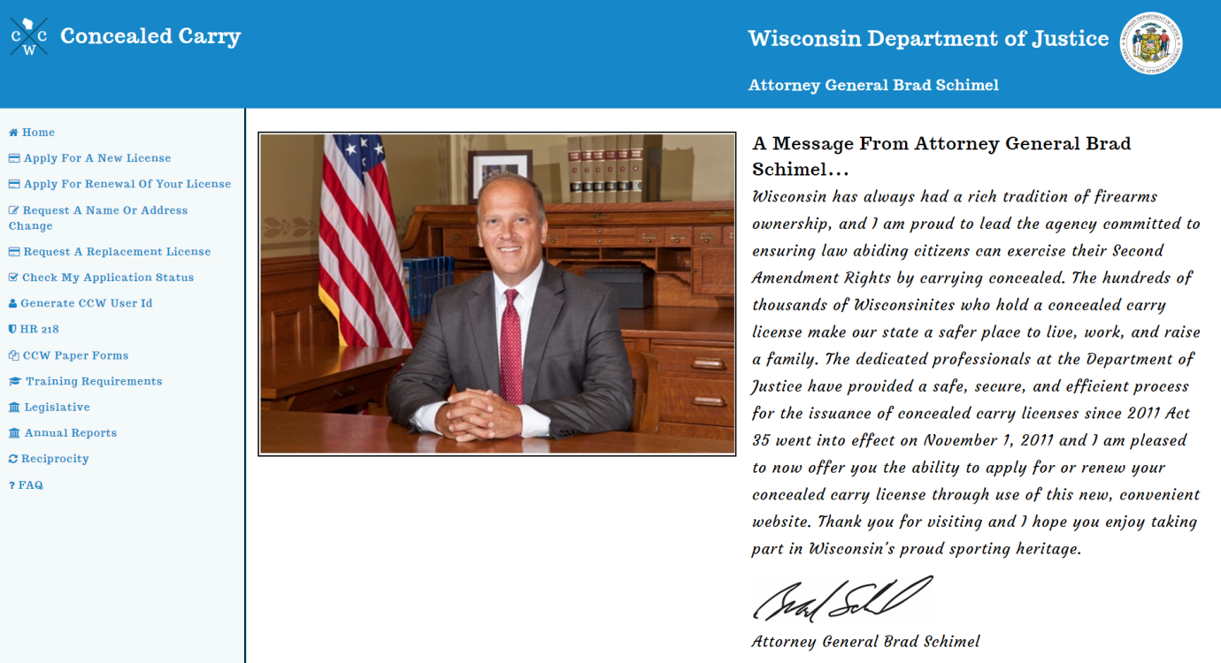
Applying for a License
May apply online or by sending in paper form
The address on application must match the address on file with the Department of Transportation
DOJ will process within 21 days
Notes:
The application can be downloaded from the DOJ website.
See the Student Guide (p. 39) or Administrative Code JUS 17 for information on criteria for proof of training documents.
“Military residents” may not have address on file with WisDOT, but must provide the number of the DL/ID card issued by their home state/residency.

Slide 71
Applying for a License
Payment
Paper: Personal check or money order for the correct amount
Online: Credit/debit card or bank transfer
Proof of training
Proof of training documents must meet specific criteria
Non-DOJ certificates require evidence the course met minimal instructional requirements
Paper: send a photocopy (originals will not be returned)
Online: upload a digital copy (.jpg, .jpeg, or .pdf)
Notes:
The application can be downloaded from the DOJ website.
See the Student Guide or Administrative Code JUS 17 for information on criteria for proof of training documents.
“Military residents” may not have address on file with WisDOT, but must provide the number of the DL/ID card issued by their home state/residency.

Slide 72
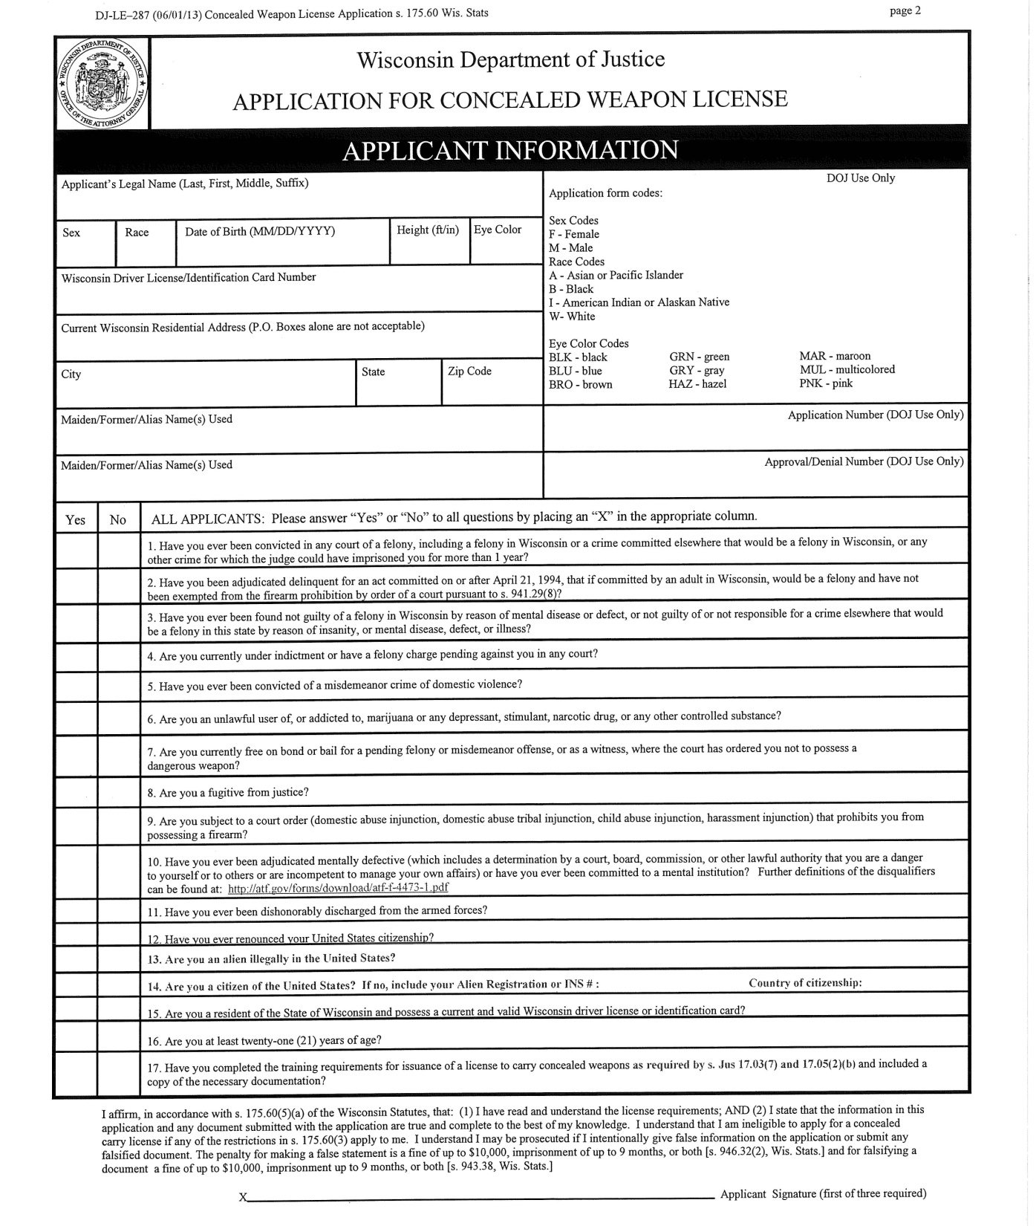
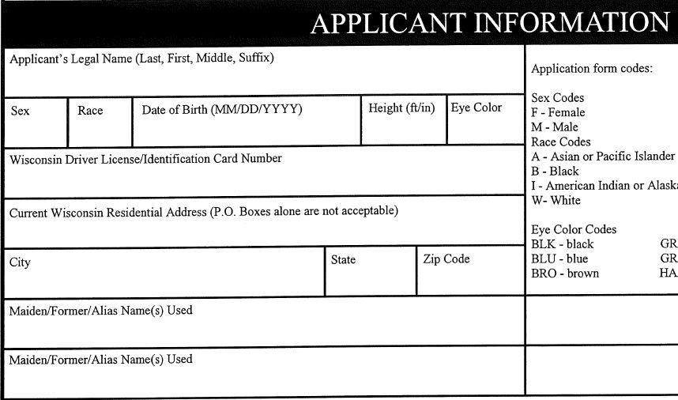
In Class Exercise: Complete an Application
Complete applicant’s information legibly
Read all questions before answering them
Some must be “yes”; some must be “no”
Sign the form in three places
Notes:
“Military residents” as defined by 2015 Wisconsin Act 67 must provide their Wisconsin residential address, and the Driver’s License/Identification Card number issued by their official state of residence (if that state is not Wisconsin).

Slide 73
Maintaining a License
Suspension
License suspended if court orders licensee to not possess dangerous weapons as bond condition
Licensee must notify DOJ when eligible to reinstate license
Revocation
License revoked if licensee becomes ineligible to possess firearms
License revoked if licensee moves out-of-state
A suspended or revoked license must be returned to DOJ within 7 days
Notes:
Give a few quick examples of what would cause someone to become “ineligible to possess firearms.”
A resident who moves out of Wisconsin is no longer a Wisconsin resident, and their CCW license will therefore be revoked.

Slide 74
Change of Name or Address
You must notify DOJ of your new name or address within 30 days
Updating your driver license with DOT does not update your address with DOJ
Two separate databases—each requires notice
To change address:
Use online website, https://concealedcarry.doj.wi.gov, or
Download form DJ-LE-285 (address)
Download form DJ-LE-293 (name)
Notes:
Renewal notices are mailed to the address you have on file with DOJ.

Slide 75
Lost, Damaged, Destroyed License
Use online website, https://concealedcarry.doj.wi.gov, or
Download form DJ-LE-285
Include the correct fee
DOJ will replace your license within 14 days of receipt
If the license was damaged, mail form DJ-LE-285 and include any remnants of your license. You will keep your license number.

Slide 76
Renewing a License
DOJ will mail a renewal notice to the address you have on file with the DOJ at least 90 days before expiration
To renew online: When you receive your renewal letter, go to https://concealedcarry.doj.wi.gov, click on “Apply for Renewal of Your License,” and enter the “User ID” from your renewal letter
To renew by mail, download renewal application DJ-LE-287R, complete it, and return by mail

Slide 77
Renewing a License
If your license expires, it is invalid
If it expires for more than 90 days, you must submit an entirely new application

Slide 78
Review: CCW Licensing
What could cause your license to be suspended or revoked?
What must you do if your license is suspended or revoked?
Does your physical license allow you to possess a weapon if your license is suspended or revoked?
What must you do if you move or change your name?
How do you renew your license?
Questions?

Slide 79
About the Final Exam
Two components: Hands-on Test and Written Exam
Hands-on test: Demonstrate how to safely unload a handgun
You choose whether a pistol or revolver
You must unload without violating any of the four fundamental rules of firearm safety
Written exam
You must score 80% or better

